Slide 1

CALIFORNIA PIZZA MANAGEMENT SYSTEM UML DIAGRAMS
MUHAMMAD OMER SIDDIQUI 19B-004-SE
CS 121 OBJECT ORIENTED PROGRAMMING

Slide 2
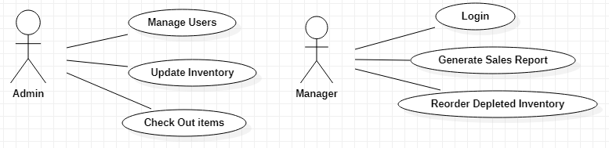
POS (Point Of Sale)

Slide 3
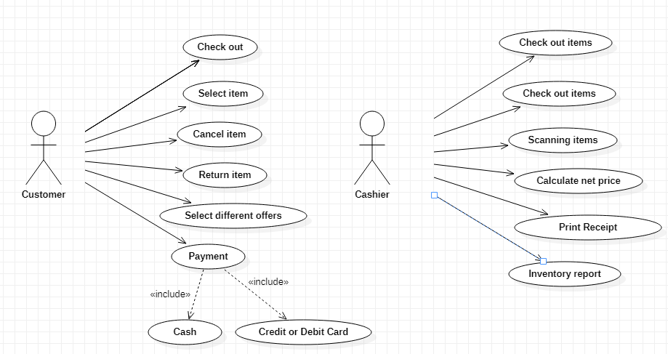
Use Case Diagram POS (Point Of Sale)

Slide 4
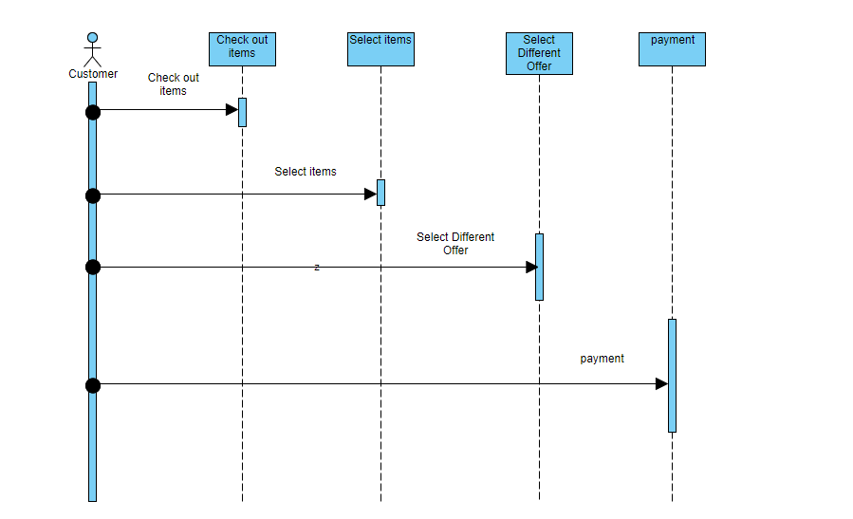
Sequence Diagram (POS System)

Slide 5
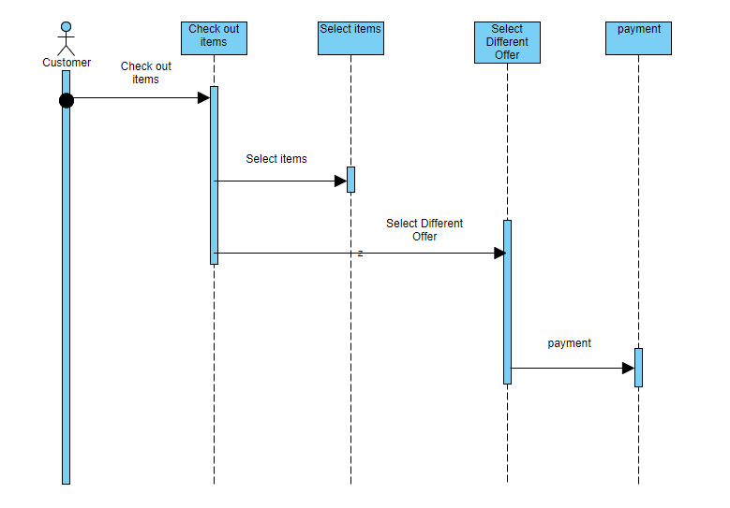
Sequence Diagram (POS System)

Slide 6
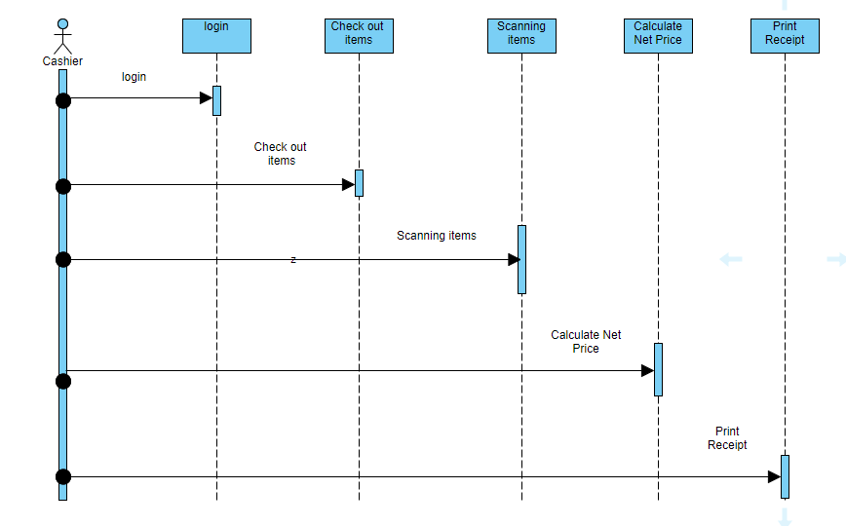
Sequence Diagram (POS System)

Slide 7
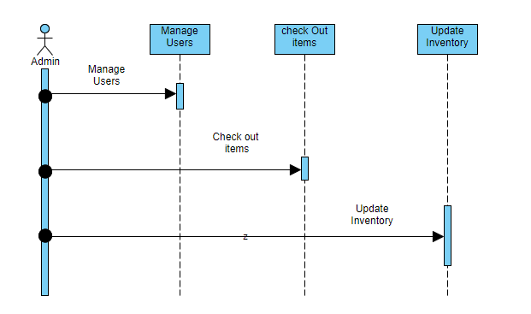
Sequence Diagram (POS System)

Slide 8
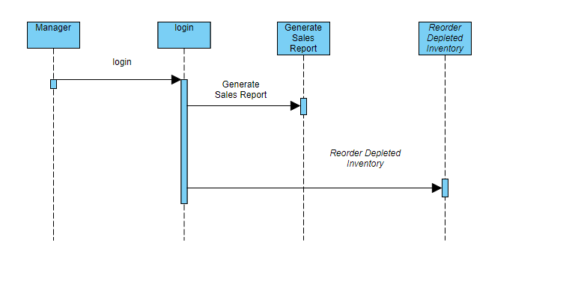
Sequence Diagram (POS System)

Slide 9
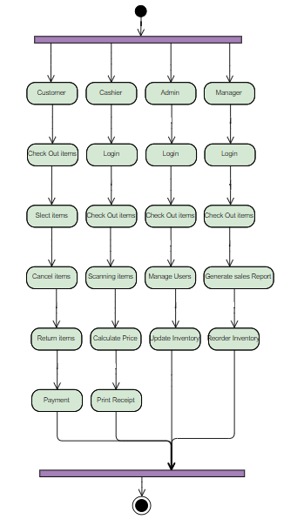
Activity Diagram (POS System)

Slide 10
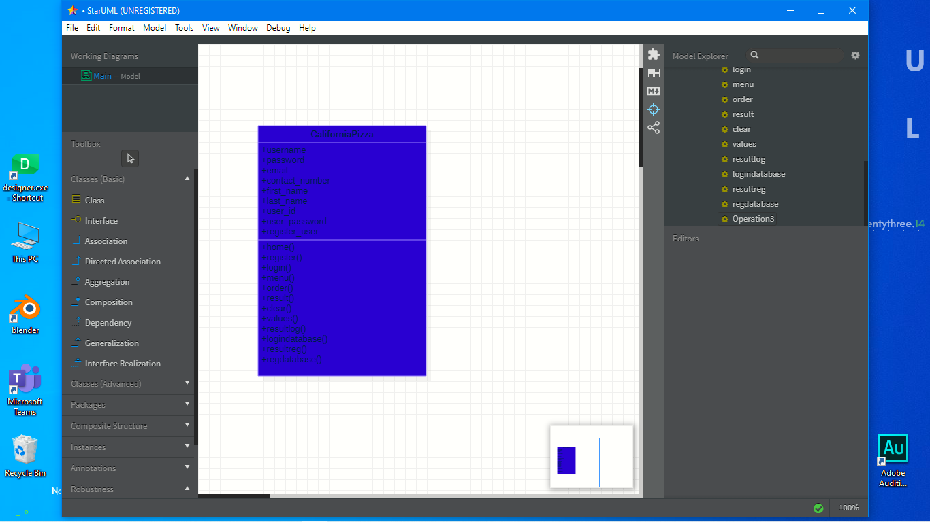
Class Diagram (POS System)

Slide 11

THANK YOU

